Slide 1

New Mexico Home Inspector Licensing Update
Where we’ve come from, where we are, where we go next…
January 22
2021

Slide 2

Your Presenter:
Jeff Gorum, Sr.
Chairman, New Mexico Home Inspector Board
Certified Master Inspector
President, InterNACHI New Mexico
Owner, Southwest Home Inspections
575-654-0213
jeff@swhomeinspections.com

Slide 3

Who, What, When and Why
Who: Qualifying Brokers, Brokers, Home Inspectors, all other constituents
Realtors lobbied for inspector licensing and NMAR made licensing of Home Inspectors a legislative priority for several years prior to passing of the Home Inspector Licensing Act during the 2019 Legislative Session
Home Inspectors, via a working committee assisted with drafting and appearing during the legislative session to show support for the legislation.
Original legislation was sponsored by Alonzo Baldonado, Matthew McQueen, Kelly Fajardo, Rod Montoya and Daniel Ivey-Soto
Original Bill can be viewed at https://www.nmlegis.gov/Legislation/Legislation?chamber=H&legType=B&legNo=433&year=19

Slide 4

Article 24D
Home Inspector Licensing Act
NMSA 61.24D
Law passed during the 2019 Legislative Session with an effective date of January 1, 2020
Board members appointed by Governor via application and Organizational meeting held January 6, 2020.
First actions included appointment of a Rules Committee to develop Rules. Committee made up of 2 Board members and 5 appointed Home Inspectors.
Rules committee met regularly, despite Covid and worked through proposed draft rules. Rules were posted as per regulation for public comment and a formal Rules Hearing was held September 14, 2020.

Slide 5
Timeline: Continued
Following the Rules Hearing, the Board officially adopted the rules on November 13, 2020, setting in motion the legal implementation of the rules…
Rules were published in the New Mexico Register on December 15, 2020
Rules formally became effective January 15, 2021
Following the rules adoption, an application committee consisting of two board members and two appointed Home Inspectors reviewed and edited the formal application form which was posted for Home Inspector use on Friday January 15, 2021.
Rules become official once they have been published in the Register for 30 days

Slide 6
Home Inspector Licensing Board
Jeff Gorum, Chair Silver City Inspector
C. Earl Greer, Vice Chair Elephant Butte Realtor
Robyn Wood-Millard Rociada Inspector
Miles Dyson Las Cruces Inspector
Tony Major Roswell At-Large
Home Inspector Licensing Act requires no more than one board member from any one county, and calls for three inspectors, one realtor and one member who is neither an inspector nor a realtor. Board meetings are held and conducted in accordance with the New Mexico Open Meetings Act.
Board Administrator:
Wayne Ciddio
wayne.ciddio@state.nm.us

Slide 7
Mythbusters Episode 1
Home Inspector Licensing Myths
Home Inspectors are required to have a license today in order to perform a Home Inspection.
Other licensed professions are able to perform a Home Inspection.
Home Inspectors may perform a Home Inspection without a signed Inspection Agreement.
There is a pre-determined format for Inspection Reports.
New Mexico Standards of Practice are identical to the Standards of Practice of both major Home Inspector Associations.
The Home Inspector gives a “Pass” or “Fail” to the home.

Slide 8
Rules and Regulations
As of January 15, 2021, the following Rules are legally enforceable in New Mexico:
http://www.rld.state.nm.us/uploads/files/Home%20Inspector%20Board%20Rules%20(003).pdf
Home Inspectors have 6 months (Until July 15) to comply with the new rules.
Any inspector performing a home inspection after July 15 without a license would be subject to Board Discipline and potentially criminal violation.

Slide 9
Application for licensure details
Application form is available at: http://www.rld.state.nm.us/boards/home-inspectors-forms-and-applications.aspx
Incomplete applications are not accepted.
Application requires the application form, Evidence of finger printing, Evidence of Experience or Field training, Evidence of passing score on the appropriate test and the application fee and initial license fee

Slide 10
Application for licensure details
Application form is available at: http://www.rld.state.nm.us/boards/home-inspectors-forms-and-applications.aspx
Incomplete applications are not accepted.
Application requires the application form, Evidence of finger printing, Evidence of Experience or Field training, Evidence of passing score on the appropriate test and the application fee and initial license fee

Slide 11
Staggered Implementation
In order to prevent a large group of initial applications from causing a surge in income for the Board followed by two years of almost no income, then a surge of renewals in the third year, a system of staggering first time licensees was written into the rules and works as follows:
License applicants born in Jan, Feb, Mar and Apr. will get a one year license initially at a pro-rated fee of $333
License Applicants born in May, June, July and Aug will get a two year license initially at a pro-rated fee of $666
License applicants born in Sept, Oct, Nov and Dec will get a full three year license at the full fee of $1000.
After the initial license, renewals will be for three years at the full fee and will become due the month before the licensee’s birth month on the year of renewal

Slide 12
Mythbusters Episode 2
Licensing means all Home Inspectors will be basically “Equal”.
Realtors and Clients will have to take an inspector’s word that they are licensed.
Home Inspectors will be able to identify Code Violations.
Home Inspectors have X-Ray vision and use it freely to identify defects in a home.

Slide 13
Questions and Answers and 5 minute break
Click the “Raise Hand” icon to ask a question!

Slide 14
The Rules
16.66.1-General Provisions
Housekeeping statements and most importantly, Definitions
Home Inspection definition
Licensure by Training and Examination
Licensure by Experience and Examination
Licensure by Endorsement
Representative Number

Slide 15
The Rules
16.66.2-Fees
$250 application fee
$1000 License Fee (May be prorated initially)
Re-activation (inactive) $50
Re-activation (Expired) $100
Re-instatement (suspended or revoked) $200
Duplicate license $50
Fees are non-refundable

Slide 16
The Rules
16.66.3-Applications and Licenses
Application by Training and Examination
  Completion of form
  Payment of fees
  Fingerprinting
  Proof of age 18 or higher and legal residence
  Completion of 80 hours of training
  Passing score on the NHIE
  Completion of 80 hours field training (minimum 30 inspections)
  Proof of Insurance

Slide 17
16.66.3 Continued
Application by Experience and Examination
Same as Application by Training and Examination insofar as the form, fees, fingerprinting and age and legal residence
Evidence of 100 inspections and inspection work in each of the 24 months preceeding January 1, 2020
Passing Score on either the NHIE or InterNACHI Home Inspector Exam with proctoring
Proof of insurance

Slide 18
16.66.3 Continued
Application by Credentials
Same as previous two categories, without passing score on a national exam, and in lieu of Experience or Education, Applicants may provide a letter from another licensing jurisdiction or agency stating that they hold an active license in good standing in that jurisdiction.

Slide 19
16.66.3 Continued
Military Service members, spouses, children and recent veterans qualify for expedited licensure and waiver of the application and initial license fees.

Slide 20
16.66.4 License Renewals
License Renewals
After initial license period, licenses renew every three years
Three year license fee is $1000
A license in good standing can be placed on inactive status at the request of the licensee
A licensee may re-activate an expired license within 90 days of the expiration

Slide 21
16.66.5 Continuing Education
Renewals
License renewal requires 60 hours of continuing education during the three year license period.
6 hours of the 60 must be in ethics
Initial one year licensees will need 20 hours of CE with 2 ethics, Initial two year licensees will need 40 hours with 4 ethics.
10% of Continuing Education logs will be audited annually

Slide 22
16.66.6 Code of Ethics
Highlights:
Conflicts of Interest Prohibited
Good Faith
Confidence in the Profession

Slide 23
16.66.7 Standards of Practice
Highlights (and variations from National Standards)
Standards were developed using primarily InterNACHI and ASHI Standards of Practice.
Pre-Inspection Agreement is required with specific language from the law.
Broad Categories of Inspection chart
Multiple identical items variation

Slide 24
16.66.8 Disciplinary Proceedings
Grounds for Disciplinary Action
Complaints and Responses

Slide 25
16.66.9 Insurance
All Inspectors must carry and provide proof to the Board of both E and O and General Liability Insurance with policy limit of $250,000 or greater.
The Board may seek competitive bids from providers for Group Insurance Policies.

Slide 26

Questions???
Press the “Raise Hand” icon…

Slide 27
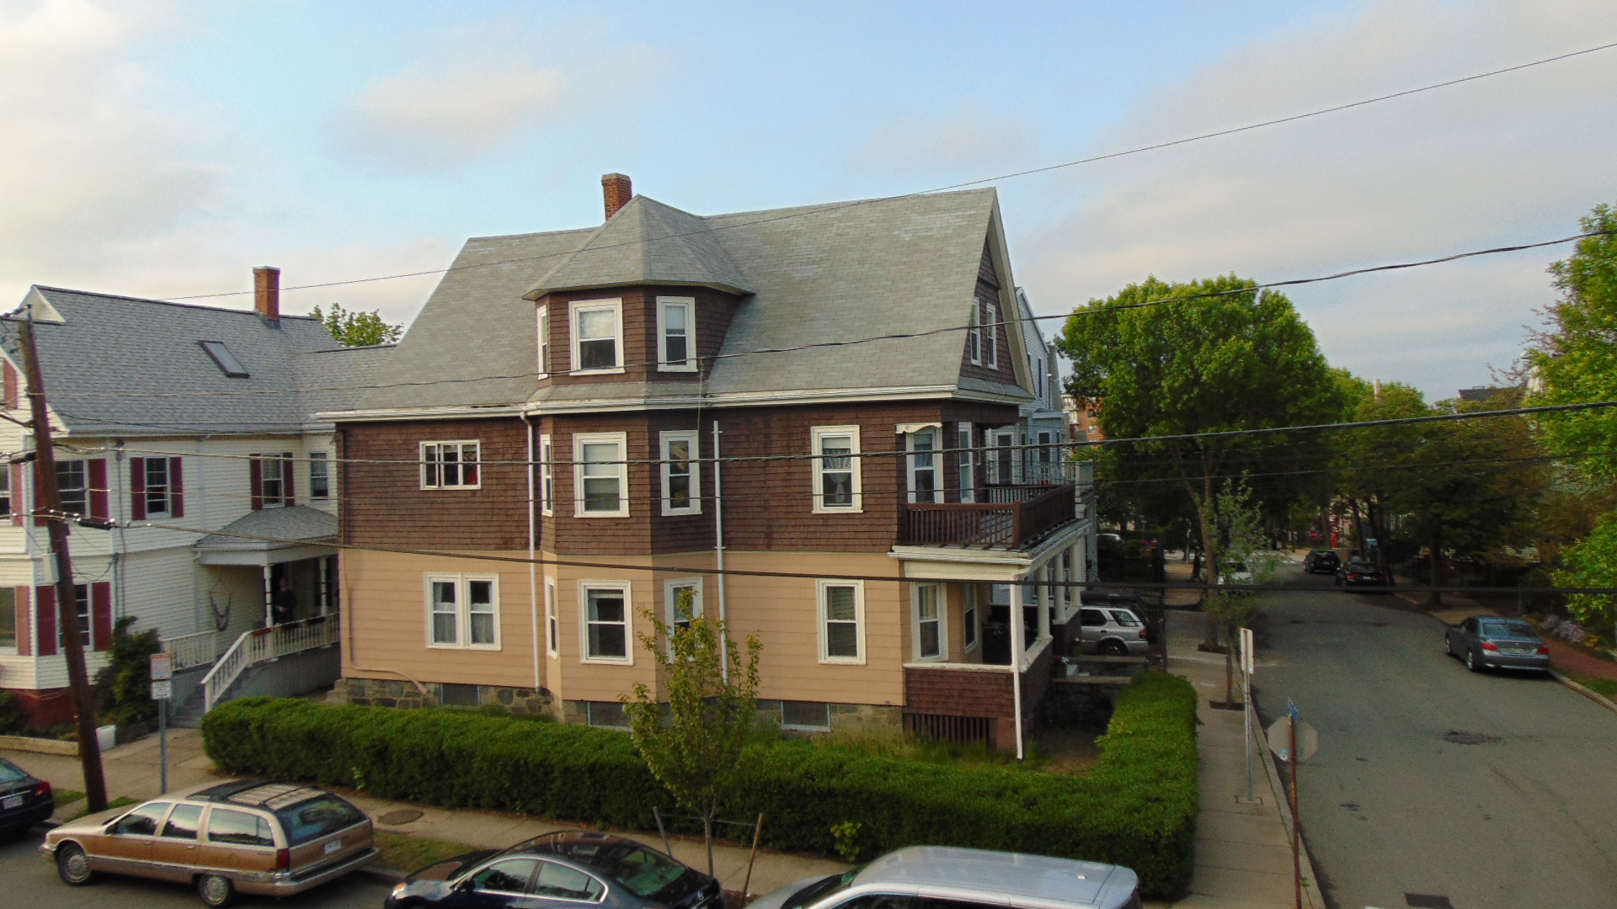
Home Inspection is about to be very different in New Mexico
We have set a minimum standard, which is good for home buyers. Keep in mind that there will always be inspectors who exceed the standard!

Slide 28

THANK
YOU!
Jeff Gorum, CMI
Phone
575-654-0213
Email
jeff@swhomeinspections.com

