Slide 1

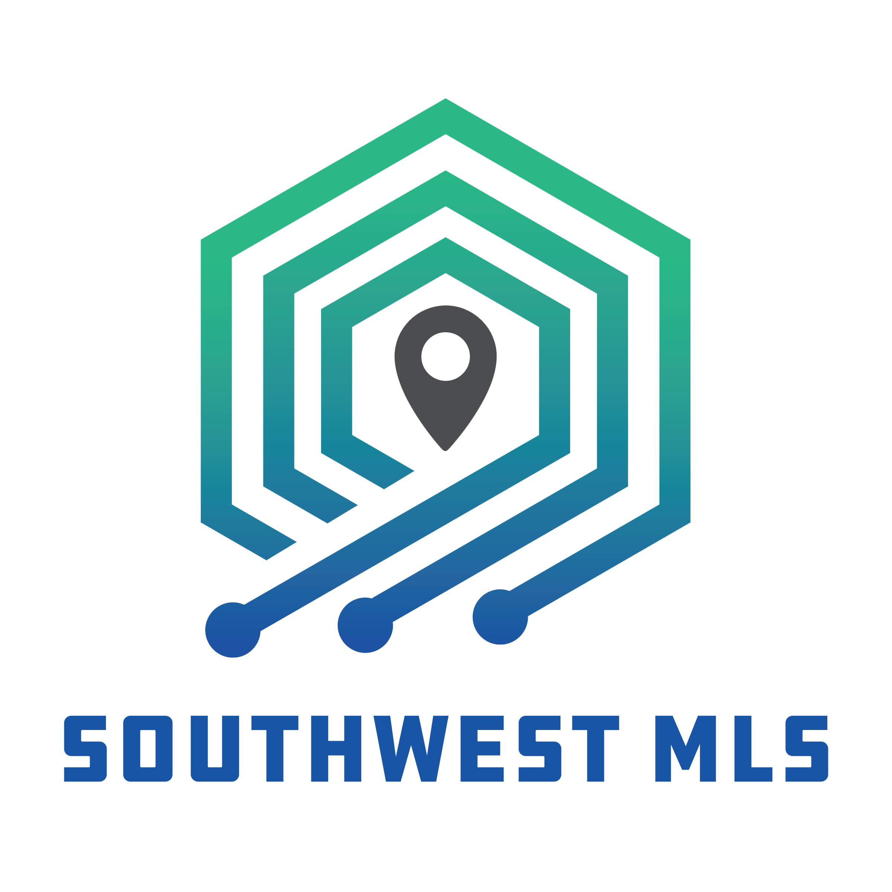
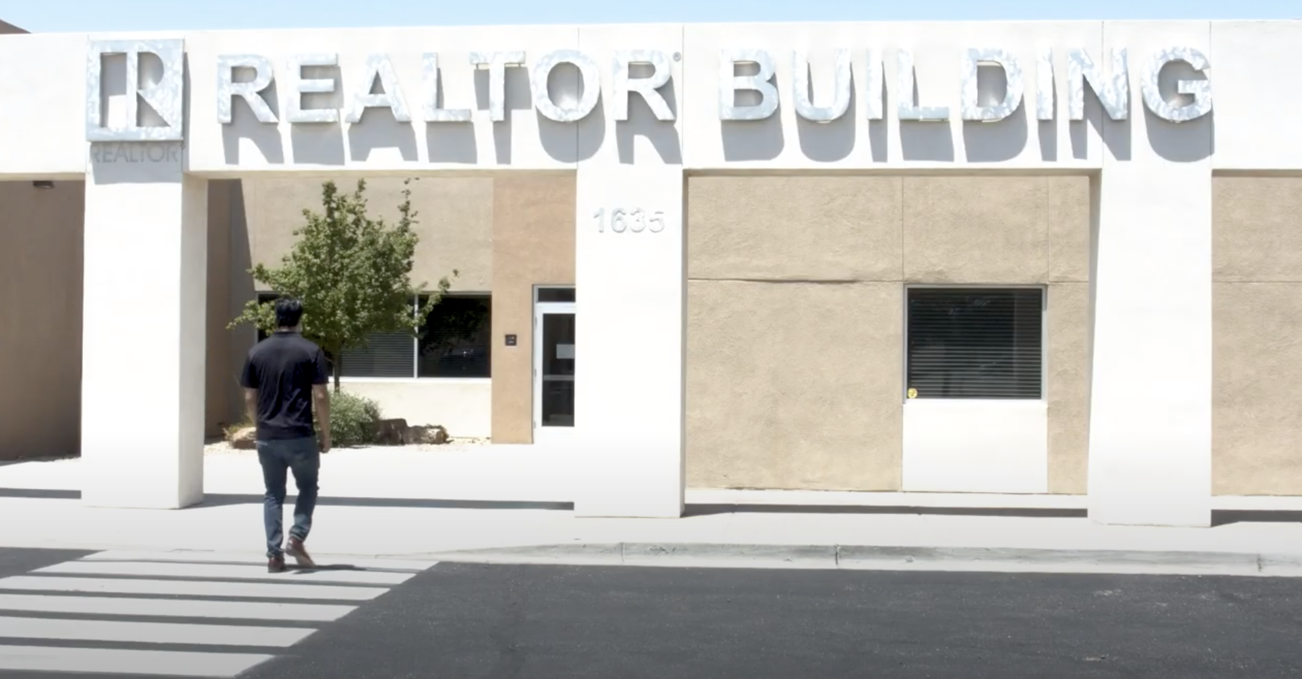
Your Successful Real Estate Career…
Using the Value of your GAAR & SWMLS Membership 20130321 – 6CE
Adrian Reyes, GSI & Kellie Tinnin, M.A. - Instructors

Slide 2
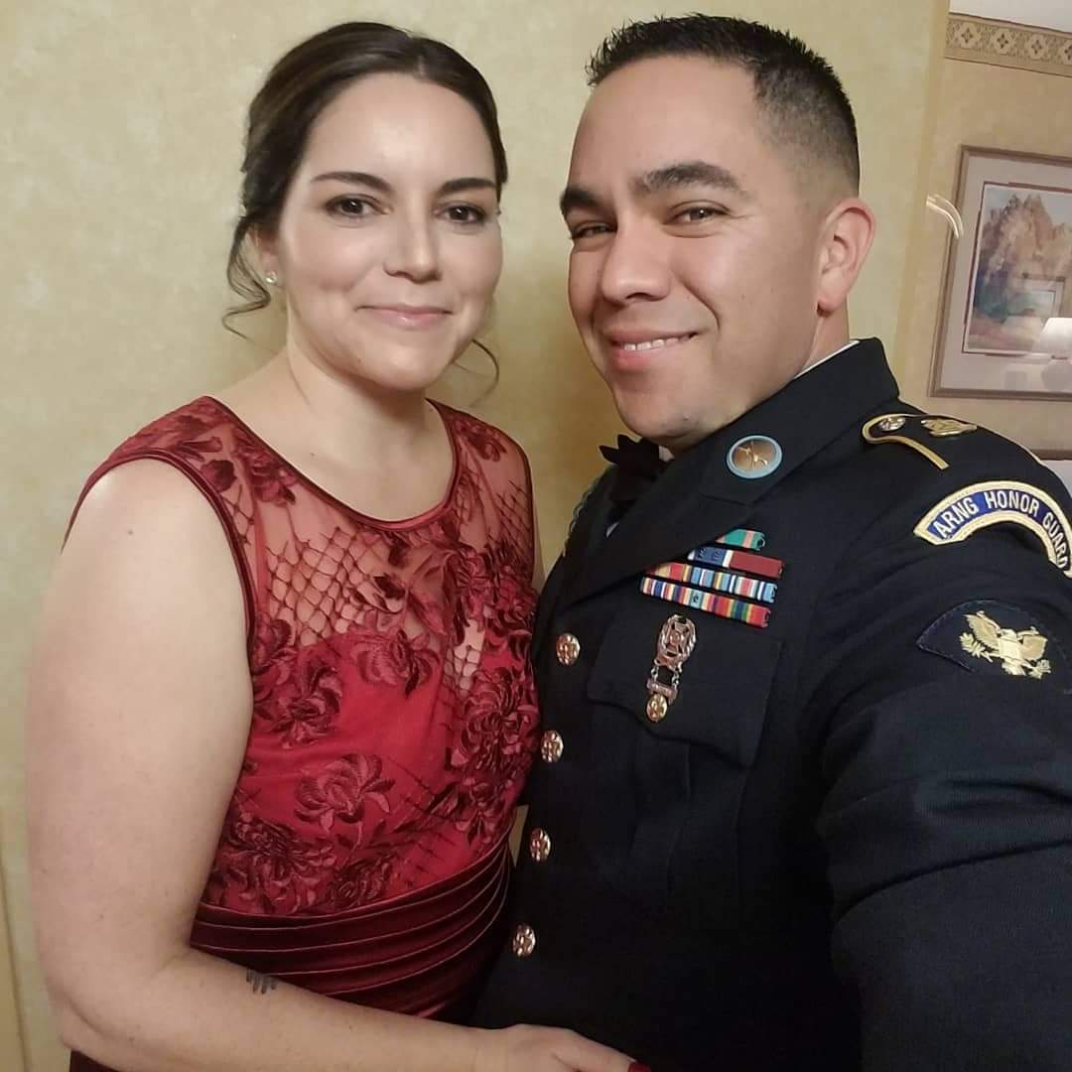


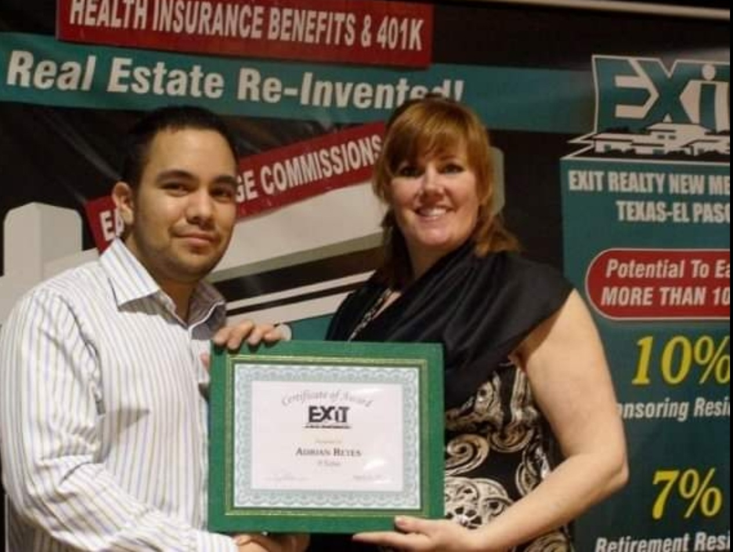
Hi, I’m Adrian!
Licensed in RE 2005 – 2008
Married to my twin flame 20 years
4 very active kids and 2 crazy dogs
11 years military (Navy & Army)
GAAR 4 years (3 depts.)

Slide 3

Hi, I’m Kellie…
Licensed in real estate since 2008.
Have two fur babies, English Bulldogs Momo and Miyagi.
I am an armchair criminologist thanks to the ID channel.

Slide 4

GAAR & SWMLS Orientation 9am-12pm
Two break periods
LUNCH BREAK
SWMLS Product & Tool Orientation 1pm-4pm
Two break periods
Where are we going today?

Slide 5


What are your pet peeves on Zoom?
Distractions
Spamming the chat
Too many “what if’s”
Misuse of Mute or Camera On/Off
Tardiness

Slide 6

So we’re not going to do any of that!
Let’s maintain a learning environment dedicated to MUTUAL RESPECT!
Notes:
Run Poll for ‘Who’s in the Class’

Slide 7
OUR OBJECTIVE…
1379
WHAT DOES THIS NUMBER REPRESENT?

Slide 8

MEMBERSHIP BENEFITS SCAVENGER HUNT!
*Included in the Course Materials. Visit SWMLS.com/Training
Notes:
Give Participants 10 minutes to search on their phones/or computers for the following information:
Discuss what their benefits are. Why they are here.
Advocacy
NAR works for you to implement, and enhance legislative objectives that affect the realtor association. This even trickles down to the state and local levels.
HOA, sick leave bills.
Consumer Outreach
NAR conducts critical and informational housing surveys about homeownership. Members have access to this data.
Information
Access to national, state and local training information. - take advantage of this.
- committees that help and support things like the Realtor fund, an endowment established in 2011. Helps support the community through giving to local charaties.
- Committees to help support professionalism in the industry. These committees you can learn a lot from
Benefits
National, state and local partnership discounts. Access to transaction forms, lockbox service, training and technology.
group 5 minutes to explore questions to find items that pertain to their membership benefits.

Slide 9





1. One way to get involved at GAAR is Political Advocacy.
What is the name of the federal political advocacy group that is funded by REALTOR® investments?
Notes:
Give Participants 10 minutes to search on their phones/or computers for the following information:
Discuss what their benefits are. Why they are here.
Advocacy
NAR works for you to implement, and enhance legislative objectives that affect the realtor association. This even trickles down to the state and local levels.
HOA, sick leave bills.
Consumer Outreach
NAR conducts critical and informational housing surveys about homeownership. Members have access to this data.
Information
Access to national, state and local training information. - take advantage of this.
- committees that help and support things like the Realtor fund, an endowment established in 2011. Helps support the community through giving to local charities.
- Committees to help support professionalism in the industry. These committees you can learn a lot from
Benefits
National, state and local partnership discounts. Access to transaction forms, lockbox service, training and technology.
group 5 minutes to explore questions to find items that pertain to their membership benefits.

Slide 10



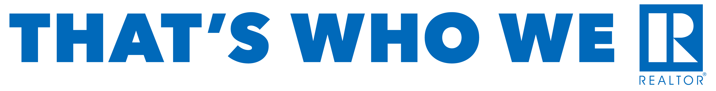
2. One-member benefit is consumer outreach. In addition to the surveys that NAR conducts, that study the real estate industry, they also communicate the value of REALTORS® through consumer advertising campaigns.
What is the name of NAR’s current consumer advertising campaign?
Notes:
Give Participants 10 minutes to search on their phones/or computers for the following information:
Discuss what their benefits are. Why they are here.
Advocacy
NAR works for you to implement, and enhance legislative objectives that affect the realtor association. This even trickles down to the state and local levels.
HOA, sick leave bills.
Consumer Outreach
NAR conducts critical and informational housing surveys about homeownership. Members have access to this data.
Information
Access to national, state and local training information. - take advantage of this.
- committees that help and support things like the Realtor fund, an endowment established in 2011. Helps support the community through giving to local charities.
- Committees to help support professionalism in the industry. These committees you can learn a lot from
Benefits
National, state and local partnership discounts. Access to transaction forms, lockbox service, training and technology.
group 5 minutes to explore questions to find items that pertain to their membership benefits.

Slide 11

3. GAAR communicates with members via email.
What is the name of the weekly newsletter that you will receive on Wednesday that communicates association news and updates?
Notes:
announce@gaar.com
Current events/meetings; CE calendar; Policy/rules information or updates; training opportunities

Slide 12

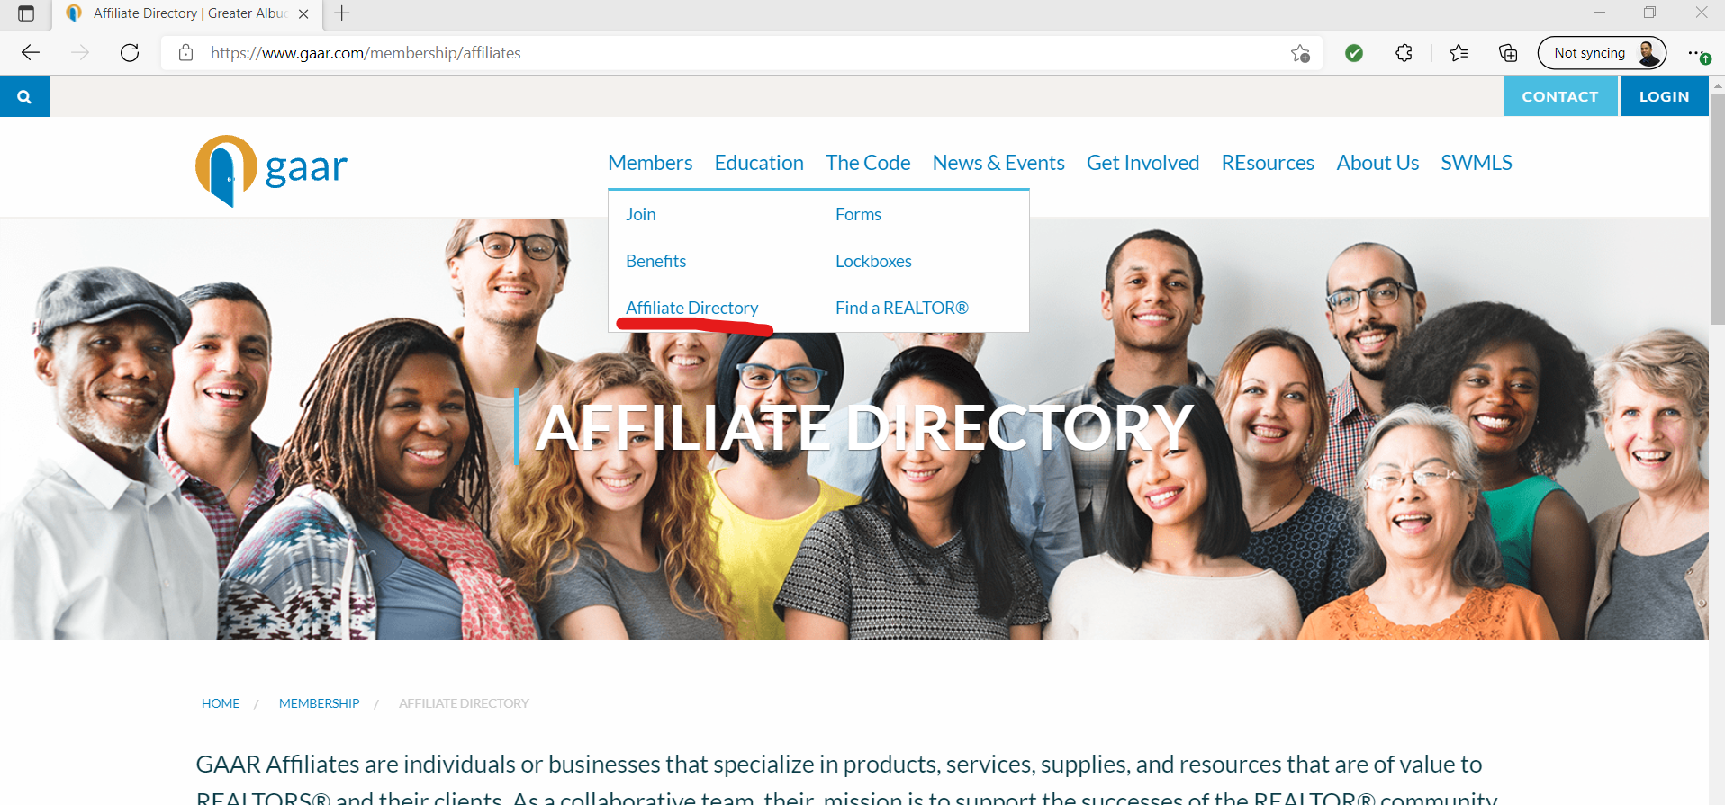
4. One GAAR member benefit is access to local vendors and companies that can help complement your business efforts.
Locate the website affiliate directory and name one Affiliate Member.
Notes:
Benefits
National, state and local partnership discounts. Access to transaction forms, lockbox service, training and technology.
group 5 minutes to explore questions to find items that pertain to their membership benefits.

Slide 13


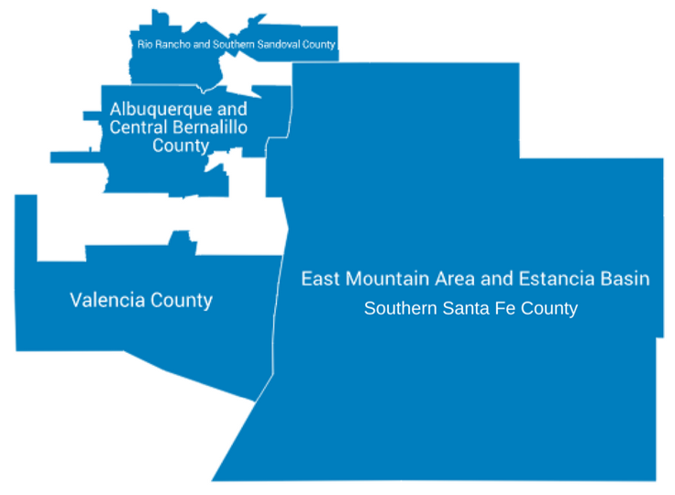
GAAR / SWMLS Service Areas
Notes:
We are GAAR/SWMLS. By joining, you are not just joining an association, you are now a member of a community that is working towards corporation among members, public, etc.
Chartered in 1921. “Real Estate Board of Albuquerque”
GAAR is the largest trade association with membership reaching over 4600
SWMLS is a wholly owned subsidiary of GAAR dedicated to providing accurate, cooperative and credible real estate information to cooperating brokers and the public.
Services: Bernalillo, Sandoval, Torrance, Valencia and parts of Socorro and Southern Santa Fe County (think Edgewood and east mountain areas)
Not every real estate broker is a REALTOR®. Membership is a privilege. All members adhere to strict Code of Ethics and Standards of Practice.
Homeownership studies, surveys and access to real estate resources through NAR.

Slide 14



Yeah, but who does what?...
Join to practice Real Estate. Your brokerage will be a member of GAAR. Your first source for training/mentoring. Your Qualifying Broker is ultimately responsible for your practice.
BROKERAGE
YOUR OFFICE
Albuquerque Metro REALTOR® trade assoc. Access to SWMLS and other products/tools. See them to transfer offices, file an ethics complaint or general guidance/direction.
YOUR LOCAL ASSOCIATION
YOUR STATE ASSOCIATION
New Mexico REALTOR® trade assoc. Advocate for private property rights. Legal hotline and forms (Instanet/Transaction Desk).
1.4 Million member REALTOR® trade assoc. Mission is to empower REALTORS® as they preserve, protect and advance the right to real property for all.
YOUR NATIONAL ASSOCIATION
STATE REGULATORY BODY
Mission is to protect the public. Manages license law and complaints from the public. See them to transfer or inactivate your license.
Notes:
Forms and access to RANM legal hotline. RANM Legal Hotline: 1-877-699-7266 (RE related questions)

Slide 15

REALTOR® Party Mobile Alerts (Call for Action) Text REALTORS to #30644
Notes:
Advocacy for homeownership and property rights. (discuss RPAC (national)/RECPAC (local) examples: HOA, flood insurance)

Slide 16
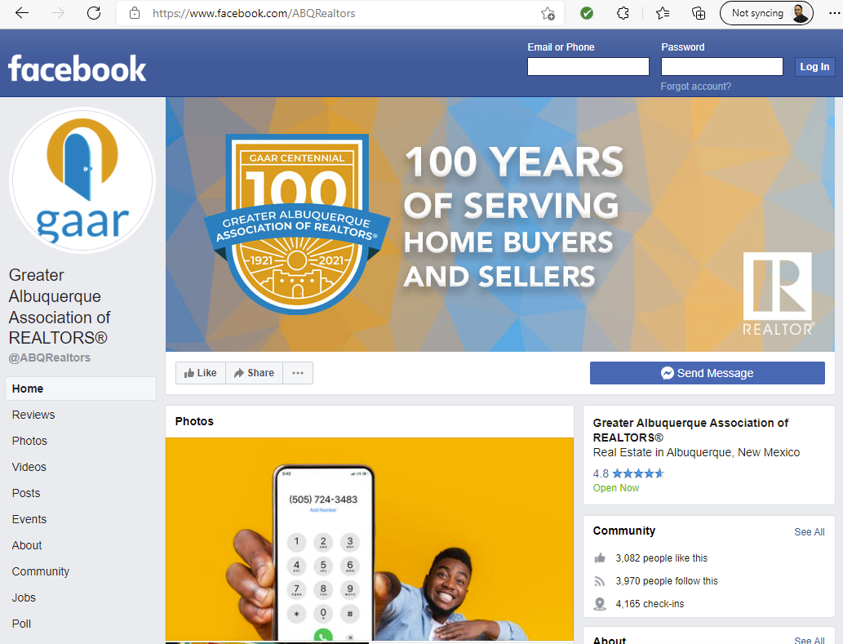
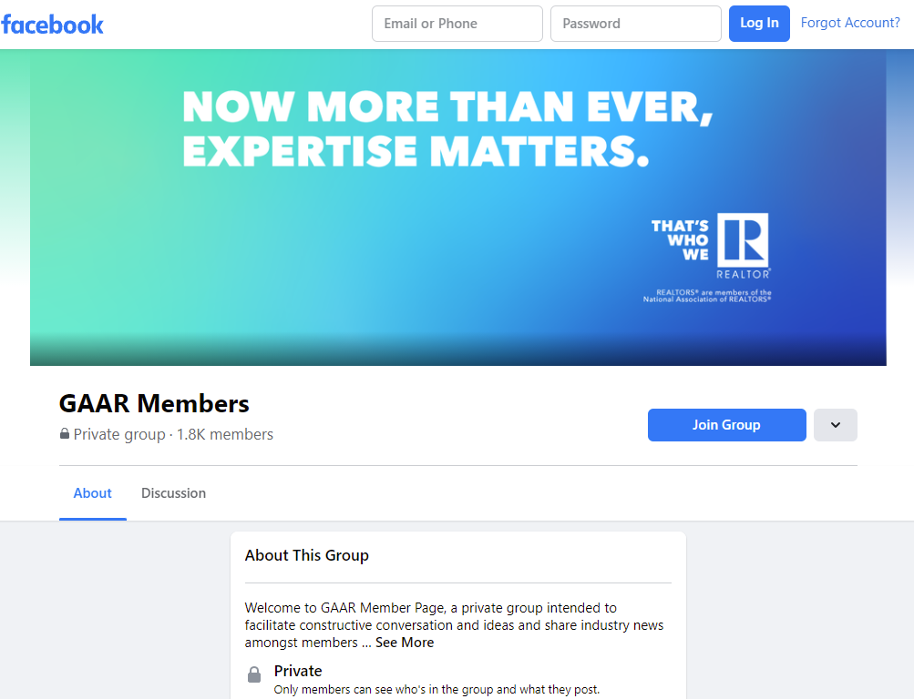



GAAR News, Events & MORE on Social Media!
@ABQRealtors
FB Groups @GAARMembers
Also check out…
Instagram @ABQREALTORS
Twitter @ABQREALTORS
YouTube @albuquerqueREALTORS

Slide 17
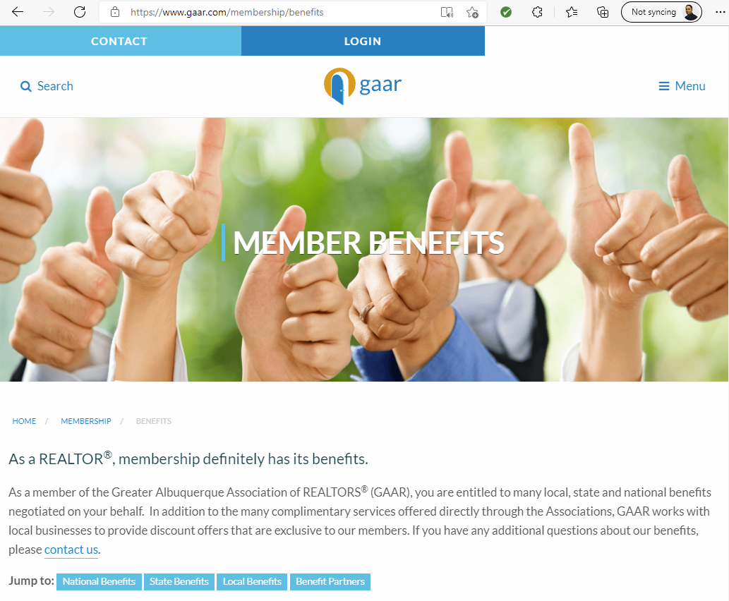
Closing gifts
Home services
Office supplies
Product discounts
And so much more!
#valueadded
#GAAR
Notes:
SWMLS access, lockbox lease program, continuing education discounts, FREE training and building use! (mention education calendar)
Resources through REALTOR® Benefits Program & GAAR Affiliate/Benefit Partner Program. - use the affiliates and benefit partners as your resource.
*GE Appliances Black Friday sale. Can refer clients for the deal
Mention GAAR Blog and Education Calendar

Slide 18

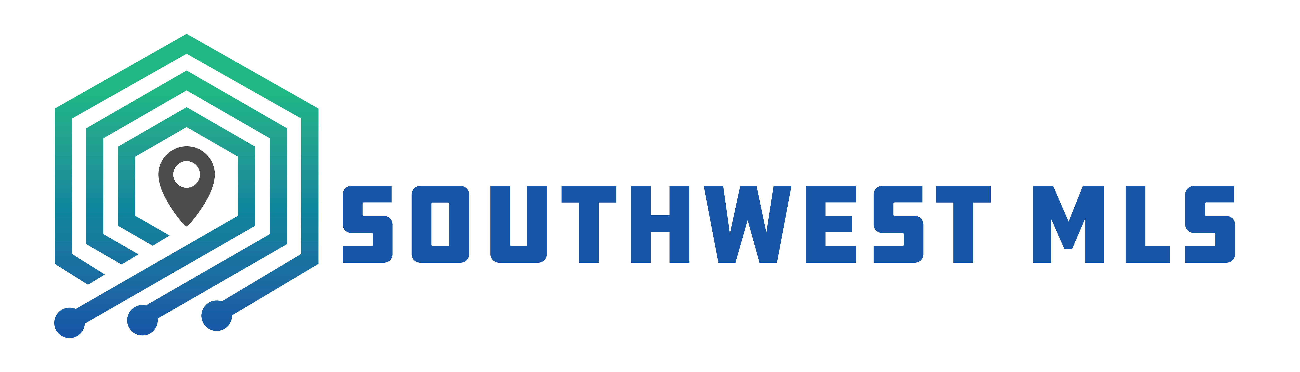







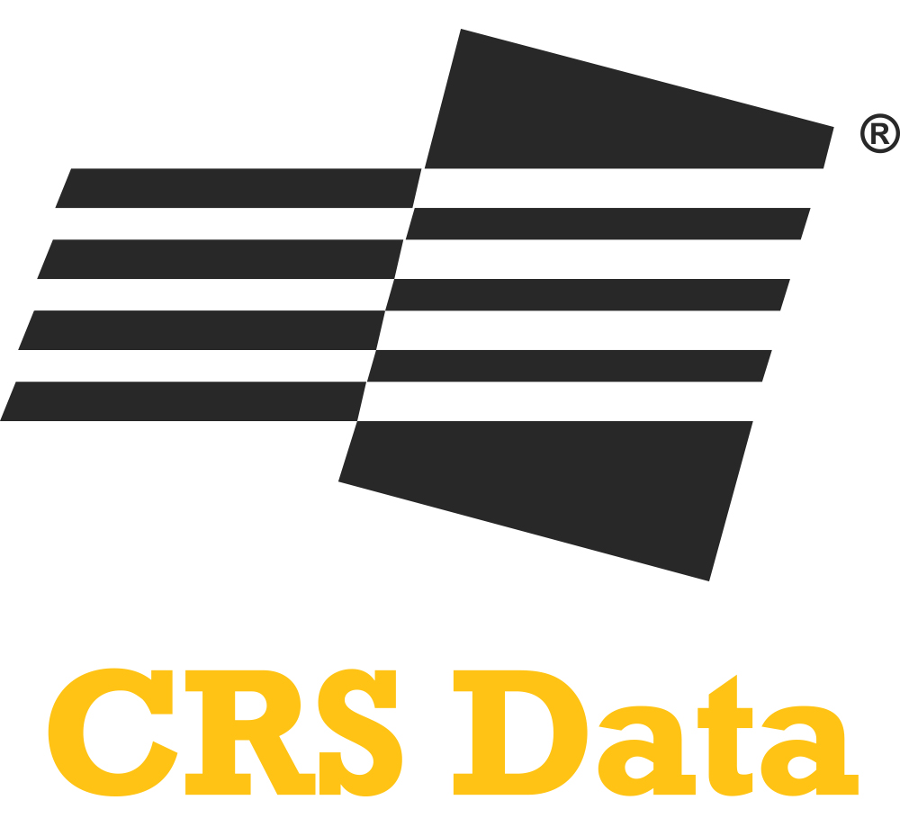

Help Desk
Member Portal
Notes:
In handout, they will have a listing of many of the products that they will use in their business each day.
Discuss what some of the products are, which ones they may use regularly.
Encourage training, education, etc.

Slide 19

SWMLS RULES JEOPARDY!

Slide 20


Slide 21
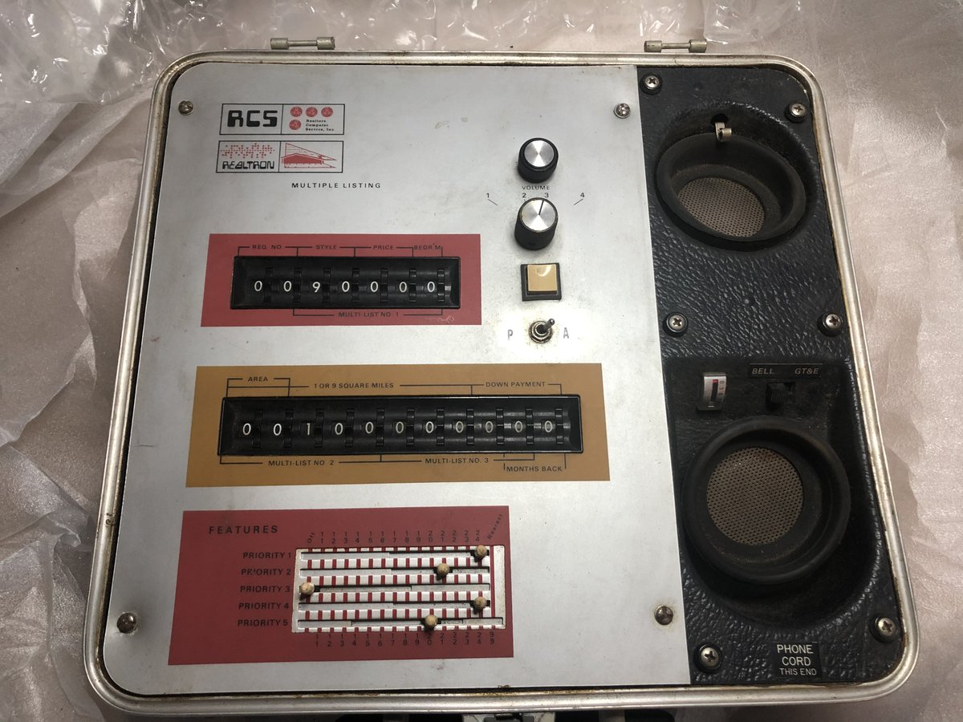
Isn’t the MLS just a Marketing Platform?
Hint…
NO!!!
MLS’s are DATA Platforms that syndicate out to Marketing Platforms.

Slide 22

Establishes rules for Cooperation.
Which is how you get PAID!
Gives consumers transparency in the marketplace.
Which builds consumer TRUST!
Maintains professionalism and industry standards.
Which builds relationships and DRIVES YOUR BUSINESS!
So, what does the MLS do for my business?
Notes:
Accurate data can consist of: parcel & tax info – square footage – property features/details – status – Lead Based Paint/PID – Sales prices – Property Types – Directions.
The MLS is used by Brokers and Appraisers to determine value.
Accurate data is important for a healthy real estate market.
Inaccurate data affects searching and marketing of listings. – ie: your listing may be missed by potential buyers.
Where to find accurate data – your seller – tax & municipal offices – appraisers – talk to your colleagues – measure your listings or have them measured – CRS program – RPR – Call GAAR!
The MLS is your agreement between brokers for compensation (co-op).
If you find inaccurate data, report it to SWMLS.

Slide 23

If you find inaccurate data REPORT IT
Inaccuracy can alter search outcome; missed opportunities!
Data is used by Appraisers to determine value
COMPLETE & ACCURATE Data are Essential! But why?
Notes:
Accurate data can consist of: parcel & tax info – square footage – property features/details – status – Lead Based Paint/PID – Sales prices – Property Types – Directions.
The MLS is used by Brokers and Appraisers to determine value.
Accurate data is important for a healthy real estate market.
Inaccurate data affects searching and marketing of listings. – ie: your listing may be missed by potential buyers.
Where to find accurate data – your seller – tax & municipal offices – appraisers – talk to your colleagues – measure your listings or have them measured – CRS program – RPR – Call GAAR!
The MLS is your agreement between brokers for compensation (co-op).
If you find inaccurate data, report it to SWMLS.

Slide 24
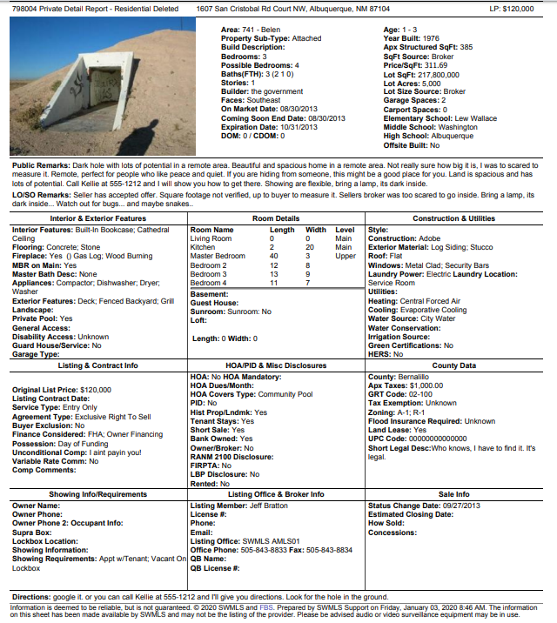
Is anything wrong with this listing??
Notes:
After discussion on the listing:
What are some sources for accurate information?
Talk about systems for consistency and accuracy.
Mention listing input form in their package.
Resources for accurate information:
Seller
Government offices
Appraisers
Floorplans
Survey
CRS program
Title offices
GAAR
QB
Affiliate Partners

Slide 25

Coming Soon – No Showings
Why do we have it?
Clear Cooperation
1 Business day
So how do we use it?
Up to 14 days
All marketing must annotate “Coming Soon”
No post factum
NO SHOWINGS!
*Included in the Course Materials. Visit SWMLS.com/Training
Notes:
The ‘why’:
CCP: Fair Housing, first and foremost. Pocket listings; equal and fair market
• Short-term status when preparing a property
• If a listing is being advertised (in any way, by anyone) the listing must be entered in the MLS within one business day (CCP).
• Allows a property with a listing agreement in effect to be displayed within the MLS to Participants/ Subscribers prior to being made Active. Does not syndicate!
• May be used for up to 14 days prior to the listing being made Active.
• All listing information must be entered, including a (front exterior) photo.
• If the listing is not made Active by the Participant/Subscriber within fourteen (14) days, it will automatically be made Active by the system on day fifteen (15).
• Advertising (of any kind) of a listing in this status must annotate the status as ‘Coming Soon’, including a ‘Coming Soon’ rider on any signs.

Slide 26
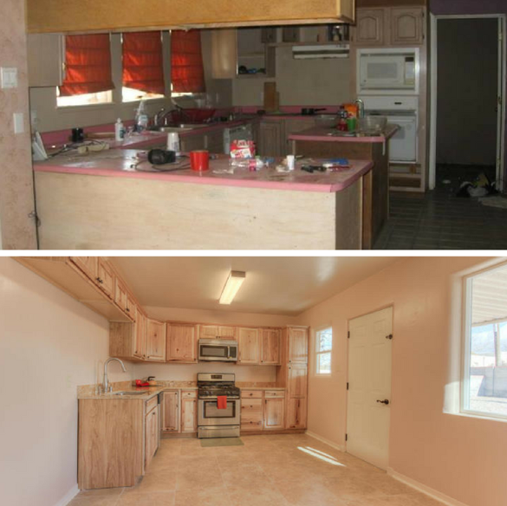
BadMLSPhotos.com…
Don’t be the next featured listing broker!
Show the space not the fixtures
Declutter and remove personal property
Use clear images
Where appropriate… hire a PROFESSIONAL!
Use descriptive words to tell a story about the property
Notes:
Minimum Photos Requirement: For All Residential Resale listing, require one photo of the living room, kitchen, bathrooms based on number, exterior front and backyard.
Exceptions for tenant occupied, substandard, or seller requests per listing agreement to not enter photos
Note that there should be at least one photo of EACH bathroom, so if it is a 1 bathroom home, there are 5 required photos, if it is a 2 bathroom home there are 6 required photos, etc.

Slide 27

Don’t end up in SWMLS jail!
Ways to risk your SWMLS privileges:
Sharing your MLS ID and Password with anyone.
Up to $5,000 FINE (possible suspension)
$500 FINE
$1,000 FINE
$5,000 FINE +30 day Suspension
Clear Cooperation Violations
Deliberately and/or consistently disregarding SWMLS Rules and Regulations
Notes:
For example: Entering a wrong address or UPC to change CDOM

Slide 28

Ways to get in hot water…
Don’t do these!
Advertising other Participant’s listings. E.g. Neighborhood flyers, newsletters, blog posts.
Giving out “Agent” Detail, and/or “Agent” Summary, Reports to clients or distributing via flyer boxes or open houses.
Up to $1,000 FINE per incident *Possible membership violation (see Article V, Section II of GAAR Bylaws)
Letting someone else use your SUPRA key.

Slide 29
OUR OBJECTIVE…
1379
Remember this??

Slide 30
Violation | Total Warnings | Total Warnings 2020 | Total Fines | Rules Class | Hearings
Advertising and Photos | 94 | 63 | 1
Compensation | 3 | 0 | 0
Lead Paint and PID | 22 | 14 | 0
Parcel and Tax Data | 222 | 6 | 2
Property Information | 29 | 14 | 1
Status (Late Status) | 55 | 27 | 0
Status (Overdue Pending) | 849 | 600 | 3
Showing Information | 0 | 48 | 0
Status - AUC | 13 | 10 | 0
Coming Soon | 10 | 2 | 0
Other MLS violations | 82 | 53 | 0
Total | 1,379 | 837 | 7 |  | 0
% of Violations with Fines | 1%
Notes:
Other MLS Violations: DOM, Duplicate Listings, General Data (Water source, Financing considered, etc.), Price, Convenience Fields (QB name/license)

Slide 31

Data accuracy helps ensure a healthy market.
What are some ways that we help ensure data integrity?

Slide 32

Data Checker
Headmaster Tools
Manual Reporting
Check It Tool
Restb.ai
Notes:
Restb.ai: No other MLS in the country is utilizing AI technology in this manner – your Southwest MLS Board of Directors, Committees, and Staff are leading this charge.

Slide 33

RESOURCES FOR YOU:
Plan Your Safety Strategy
Training Videos
Tips and Best Practices
Personal Protection Resources
Create a Safety-minded Culture
*Included in the Course Materials. Visit SWMLS.com/Training

